Slide 1
NLP-Driven Query answering and summarization for amazon reviews
GROUP - 11
Team Members:
Meghana Sadhu-11726080
Mahitha Sudini-11652795
Greeshma Vemula-11699541
Preethi Medipelli-11733471
Notes:
Delete this slide when you finish preparing the other slides.

Slide 2

Introduction
In today’s digital age, the vast amount of data generated across various platforms presents both opportunities and challenges. As users mainly rely on reviews while purchasing online, it is important to extract crucial information from this data.
This project focuses on two interrelated applications: Question Answering and Contextual Summarization.
Information Extraction: It is a subfield of NLP that aims to relevant extract information from datasets. This can be achieved by using TF-IDF vectorization.
Question Answering with Summarization: This involves providing concise summaries that preserve the context of the original text. Utilizing RoBERTa and BART model, this approach synthesizes information from multiple reviews and creates a summary.

Slide 3

Problem Statement
As the volume of online reviews on Amazon increases, users face challenges in efficiently extracting information to make decisions while purchasing. They often experience information overload and struggle to find correct answers to specific questions. This can be time taking and leads to frustration. By integrating question answering and contextual summarization, this project aims to help users by providing direct answers and comprehensive insights.

Slide 4
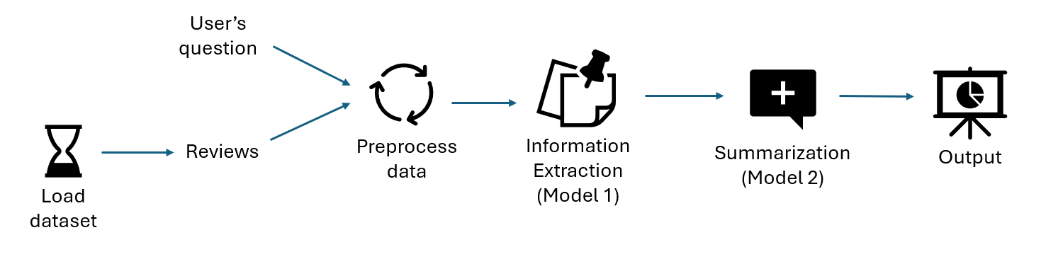
Workflow diagram

Slide 5
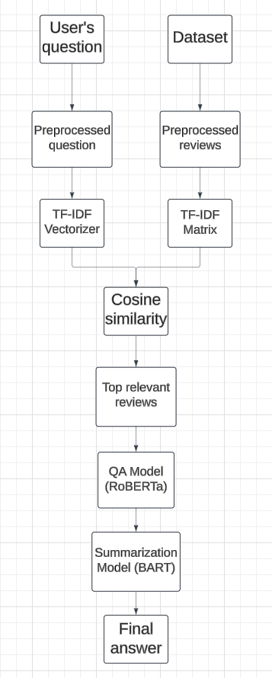
Architecture diagram
Both user’s question and reviews are preprocessed by cleaning and standardizing. It prepares the text for vectorization process.
Preprocessed question is converted into vector and preprocessed reviews are converted into vectors and stored in a matrix.
Cosine similarity is calculated between the question and each review vector by providing a measure of how closely each review matches the question.
Top relevant reviews are selected based on cosine similarity.
These reviews are passed to QA model which processes each review and extracts answers.
The extracted answers are summarized into a simple answer using BART model.

Slide 6
DATASET
The dataset used for this project is based on the Amazon US Customer Reviews on Digital Video Games from Kaggle which is publicly available.
Source: /https://www.kaggle.com/datasets/cynthiarempel/amazon-us-customer-reviews-dataset?select=amazon_reviews_us_Digital_Video_Games_v1_00.tsv
It has 145,431 rows and 15 columns, namely marketplace, customer_id, review_id, product_id, product_parent, product_title, product_category, star_rating, helpful_votes, total_votes, vine, verified_purchase, review_headline, review_body, review_date.

Slide 7
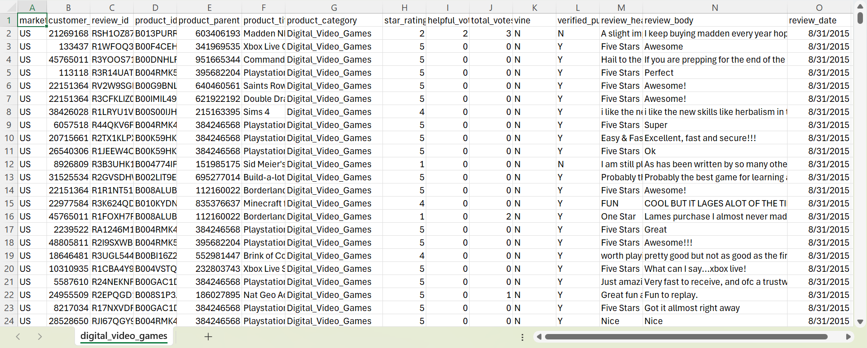
DATASET REPRESENTATION

Slide 8
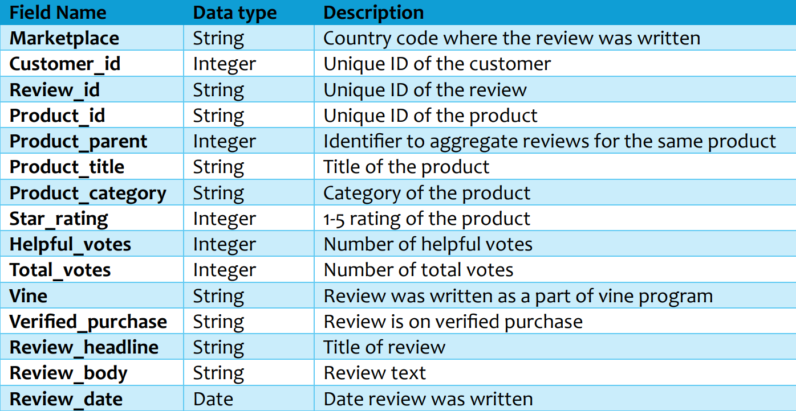
Features of dataset

Slide 9

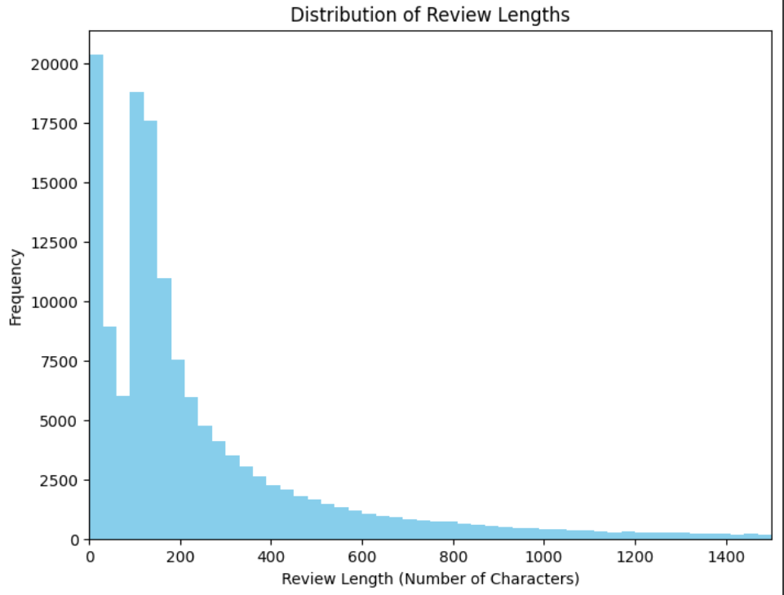
Data VISUALIZATION
Histogram showing distribution of review body lengths from dataset:

Slide 10
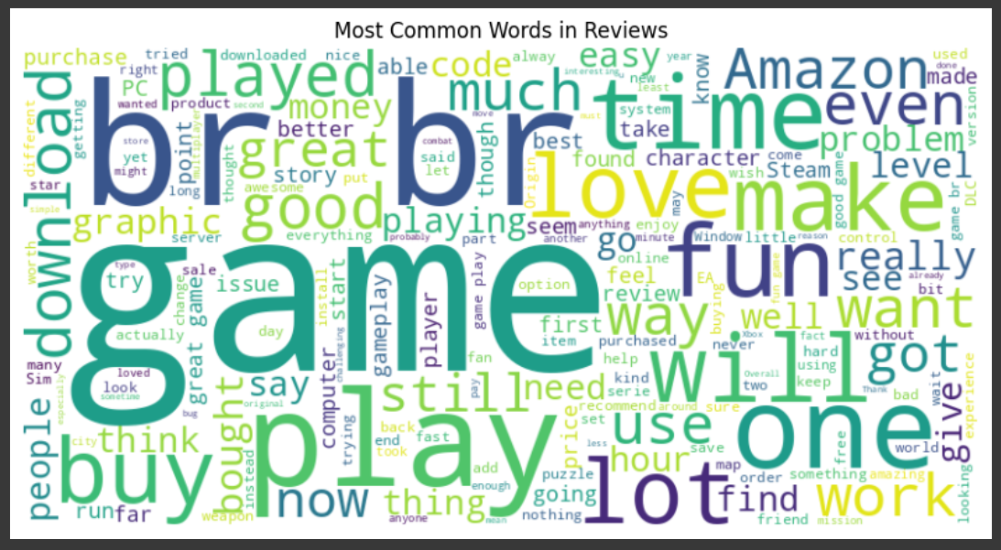
Word cloud of frequent words in reviews

Slide 11
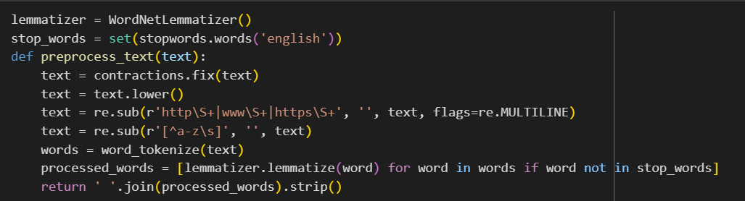
DATA PREPROCESSING
It is important to perform data preprocessing for effective analysis. It is going to prepare both user’s question and review texts.
This step includes expanding contractions which makes the text more explicit, lowercasing text so that they are treated same, removing stopwords, URLs and special characters, tokenization and lemmatization.
This helps in cleaning and standardizing text which is useful for to get more accurate results in the next step.

Slide 12
Steps of the model
Step 1: Load pre-trained models (RoBERTa and BART) and dataset
Step 2: Preprocess the input data
Step 3: Calculate TF-IDF and cosine similarity
Step 4: Select relevant reviews
Step 5: Extract answers using QA model
Step 6: Combine all extracted answers
Step 7: Summarize the combined answer using BART
Step 8: Output the final answer

Slide 13
Implementation libraries
Nltk: It is used for text preprocessing tasks
Transformers: It is used for loading models like RoBERTa, BART
Sklearn: It is used for IT-IDF vectorization and cosine similarity calculation
Pandas: It is used to handle the dataset
Contractions: It is used for expanding contractions
Re: For cleaning text based on regular expressions

Slide 14
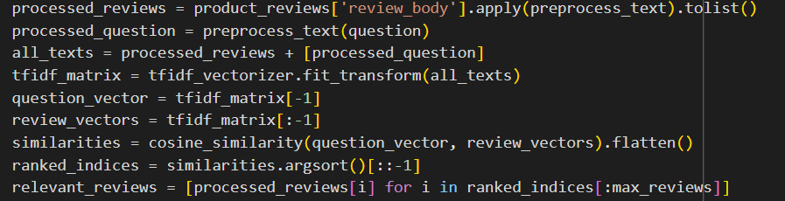
explanation
Review Extraction:
This is the first model which identifies most relevant reviews to a user’s question.
The preprocessed question and review text are converted into TF-IDF vectors. It identifies important terms and assigns higher weights.
After vectorizing, we calculate cosine similarity between the question vector and each review vector. The identified relevant reviews are sent to next model.

Slide 15
Question Answering with summarization:
This is the second model which takes the output from the first model and extracts answers to the question by summarizing them.
This is done using RoBERTa QA model. It identifies the relevant text that answers the question.
All these answers are combined and sent to the BART summarization model.
It generates a human-readable summary that has all the key points from the extracted answers.

Slide 16
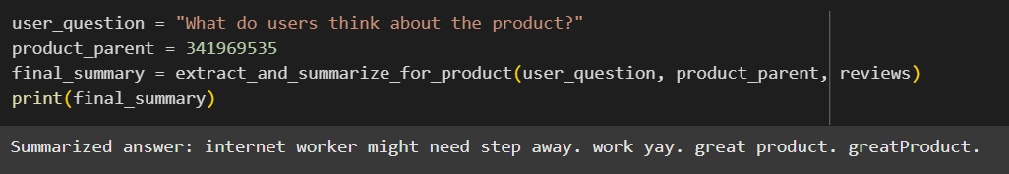
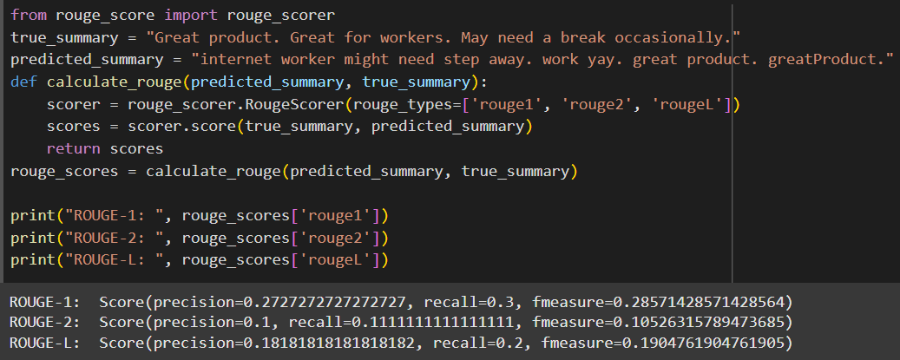
results
The output is a summarized answer of all the related reviews.
The performance is evaluated using ROUGE-N

Slide 17
Project management
This project successfully integrates two models by sending first model’s output to the second as input and produces final output.
The issue with this model is there is not enough resources for larger dataset and no fixed data for testing the model effectively.
Responsibilities/Contributions:
Introduction, problem statement – Preethi (25%)
Methodology – Greeshma (25%)
Dataset, data analysis – Mahitha (25%)
Implementation, results – Meghana (25%)

Slide 18
references
R. Rajat, P. Jaroli, N. Kumar and R. K. Kaushal, "A Sentiment Analysis of Amazon Review Data Using Machine Learning Model," 2021 6th International Conference on Innovative Technology in Intelligent System and Industrial Applications (CITISIA), Sydney, Australia, 2021, pp. 1-6, doi: 10.1109/CITISIA53721.2021.9719909.
Mansi Gupta, Nitish Kulkarni, Raghuveer Chanda, Anirudha Rayasam, Zachary C Lipton, “AmazonQA: A Review-Based Question Answering Task”, https://doi.org/10.48550/arXiv.1908.04364
/https://www.kaggle.com/datasets/cynthiarempel/amazon-us-customer-reviews-dataset?select=amazon_reviews_us_Digital_Video_Games_v1_00.tsv

